Slide 1
New York Trade Simply Trading
Prakash Shahi Thakuri

Slide 2
Background
New York Trade is an Trading app. When you are a student, you are always short of money and sometimes you have stuff that you don't use any longer and have no values to you. But you are always wanting to get the item you wanna use. Similar case happens to another student.
Sometimes, what one student needs are with the student, who does not use at all (which they wanna get rid off). This app help to the students who wanna buy things(books, gadgets) they need but short of money. So they can trade with their items. They can also buy with the money.

Slide 3
Trageted User Example
Prakash is a graduate student at Pace University. As a student, he does not work so he is always short of money. He sees the unnecessary things he posses (iPhone 6s) and posts on the NewYork Trade to trade his iPhone with Camera.
In the other side, Chandra is an undergraduate student at Touro College. He is also a student, so he has a similar problem as Prakash has. He finds out he does not use his camera and wants to trade and get an old iPhone. So he goes to NewYork Trade and finds out Prakash has posted an iPhone to trade with Camera.
So they trade their iPhone and Camera with each other.

Slide 4
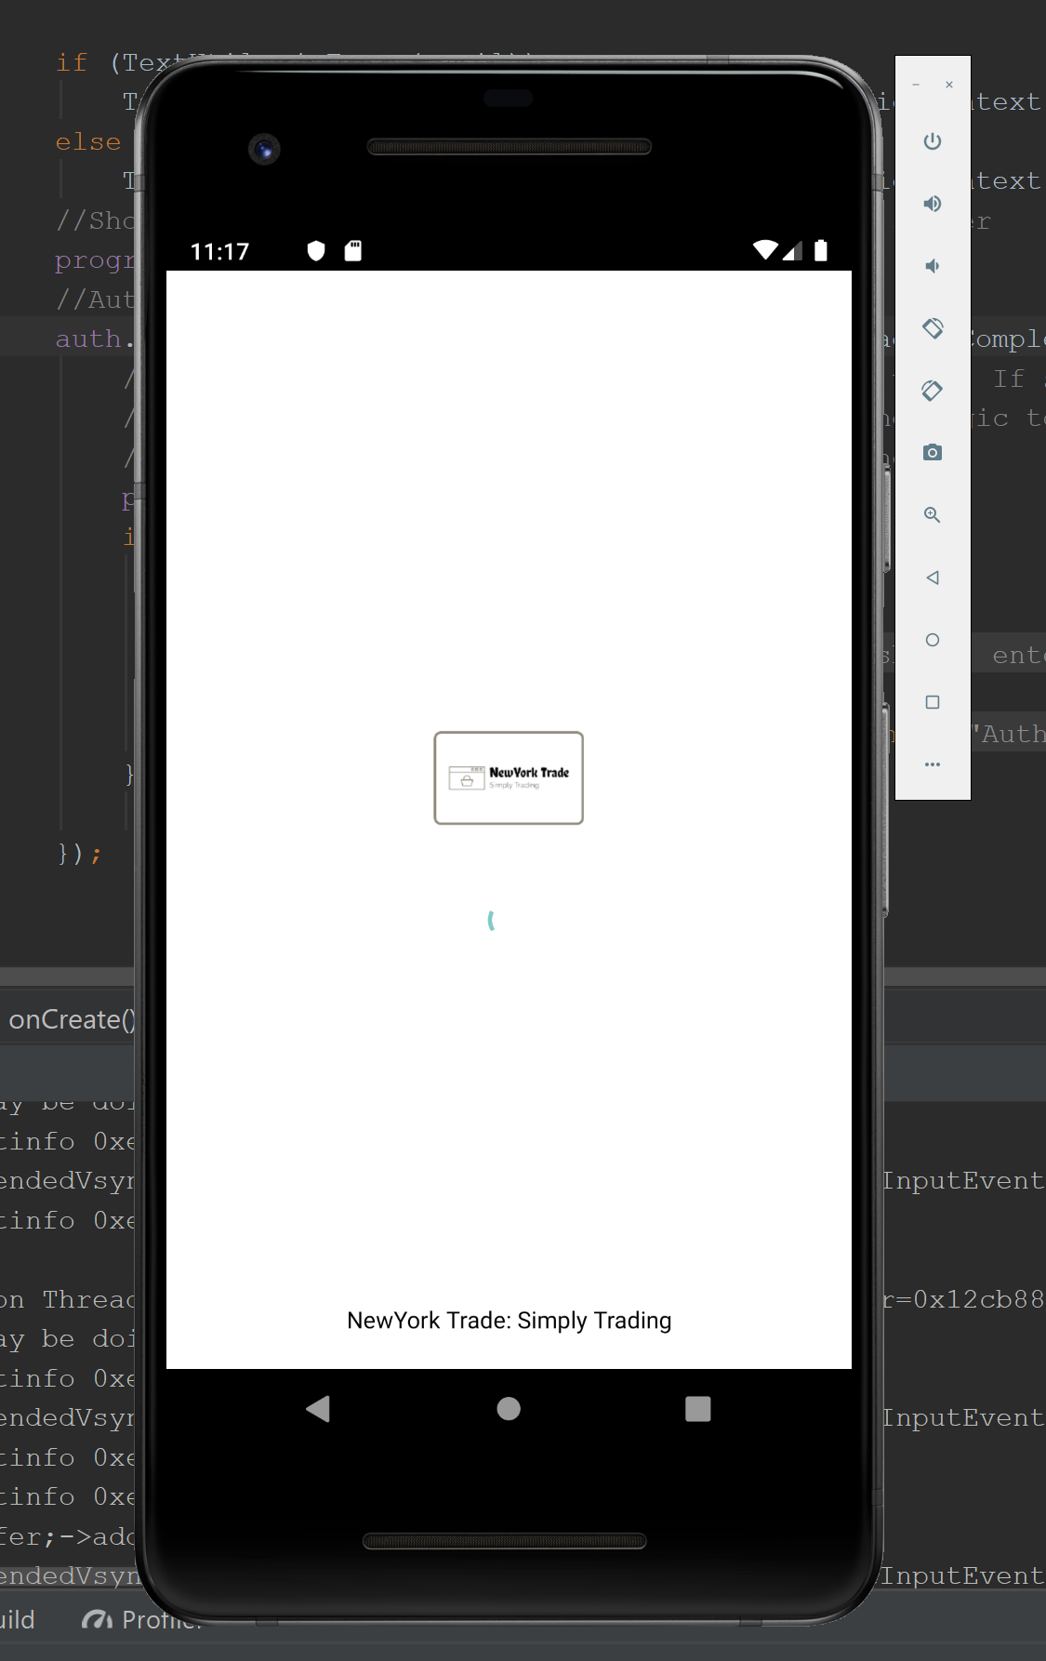
Splash Screen

Slide 5
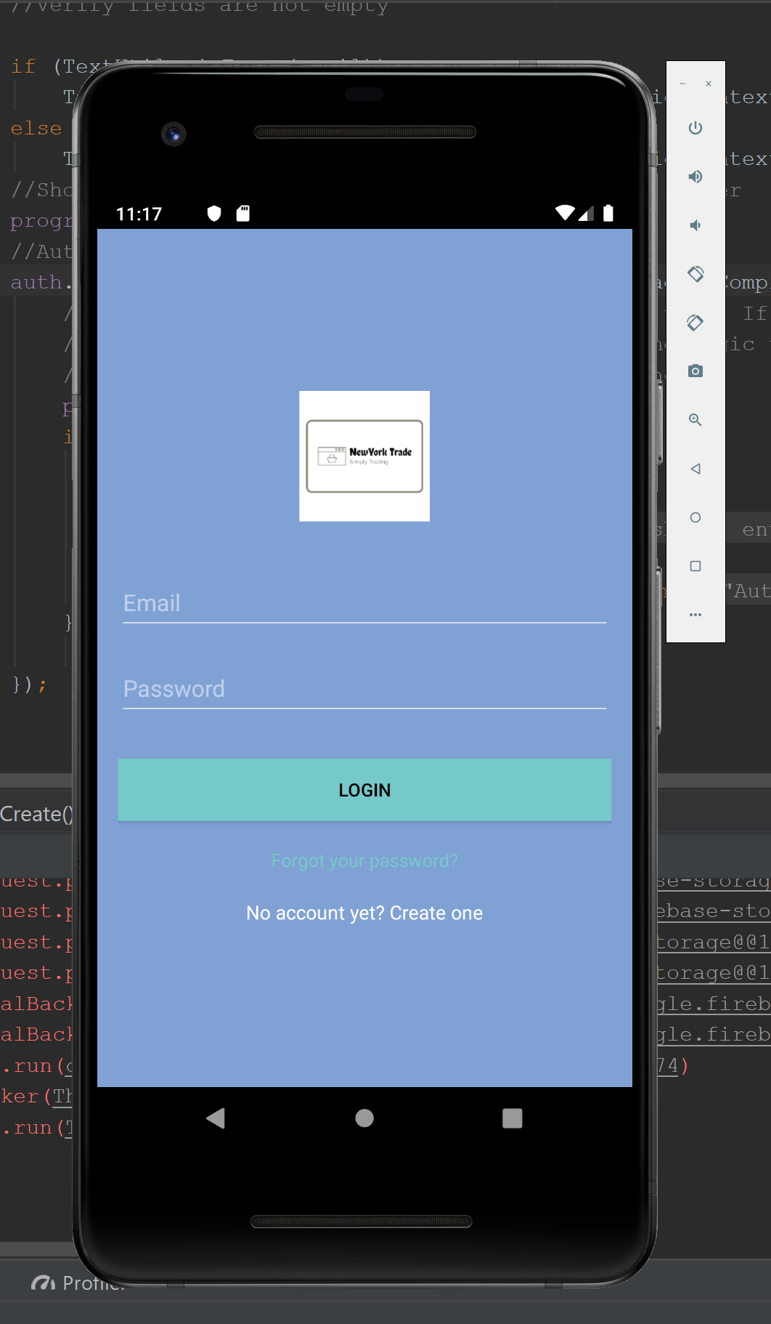
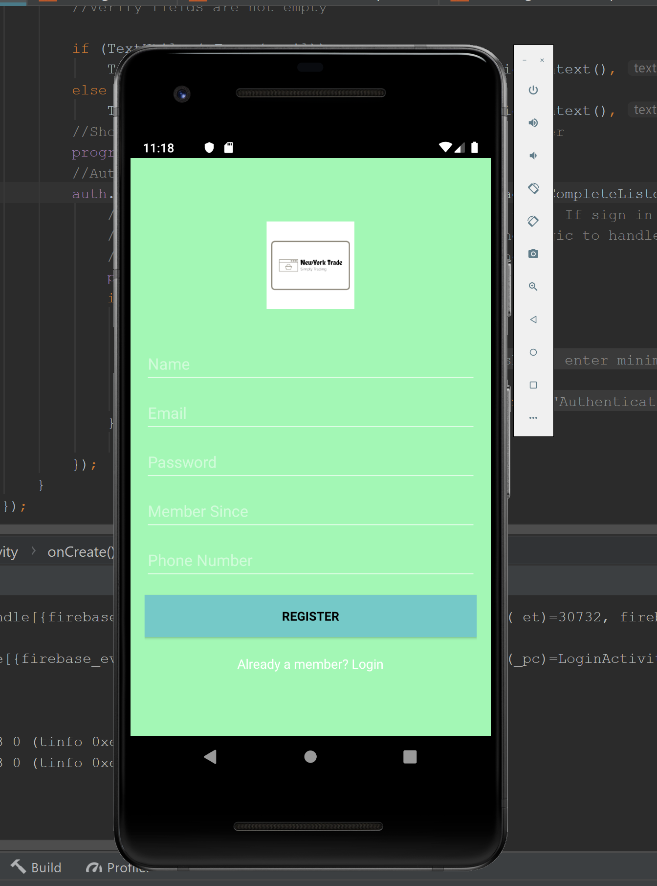
Login / SignUp Screen

Slide 6
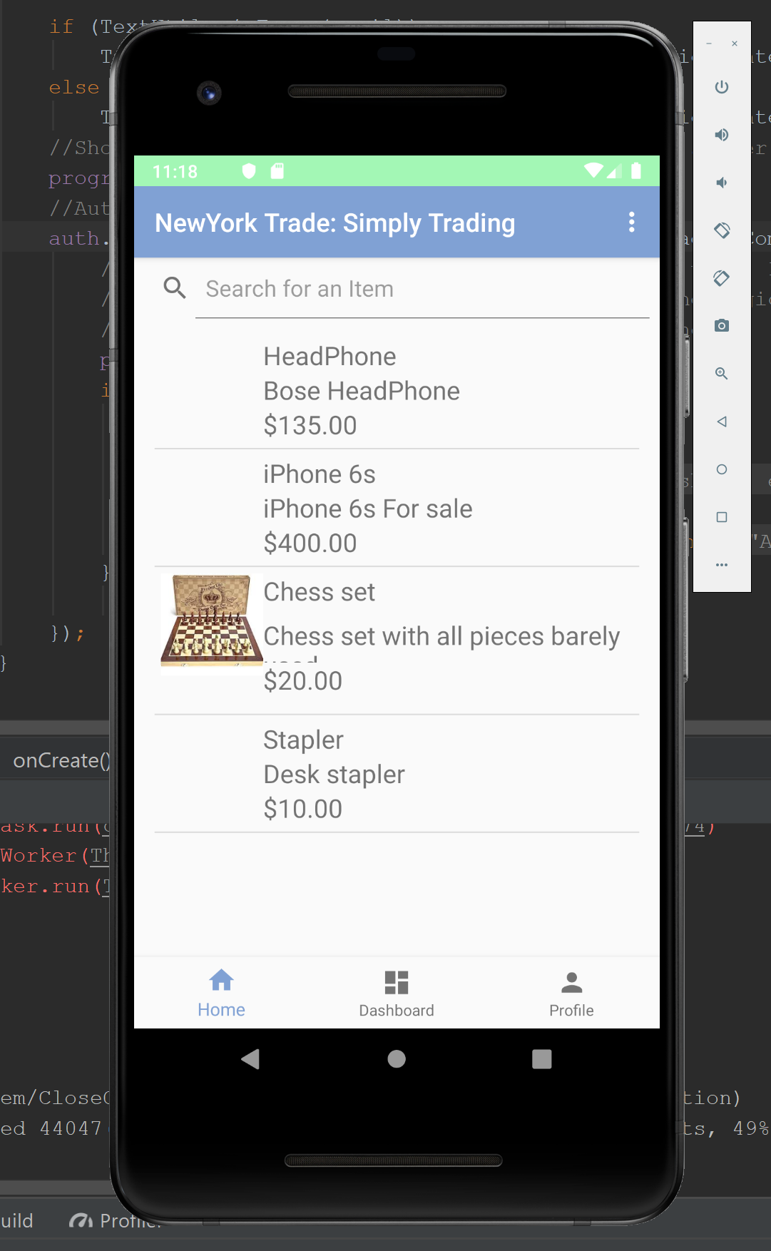
Home Page / Landing Page

Slide 7
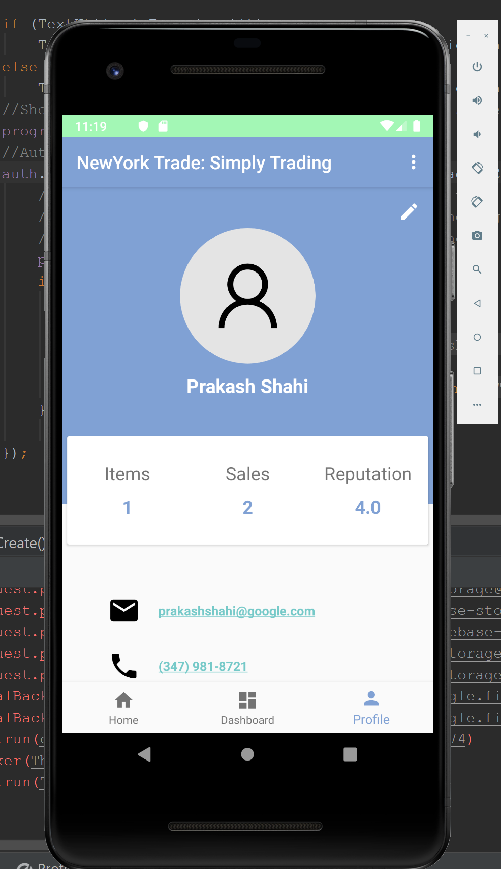
Profile Page

Slide 8
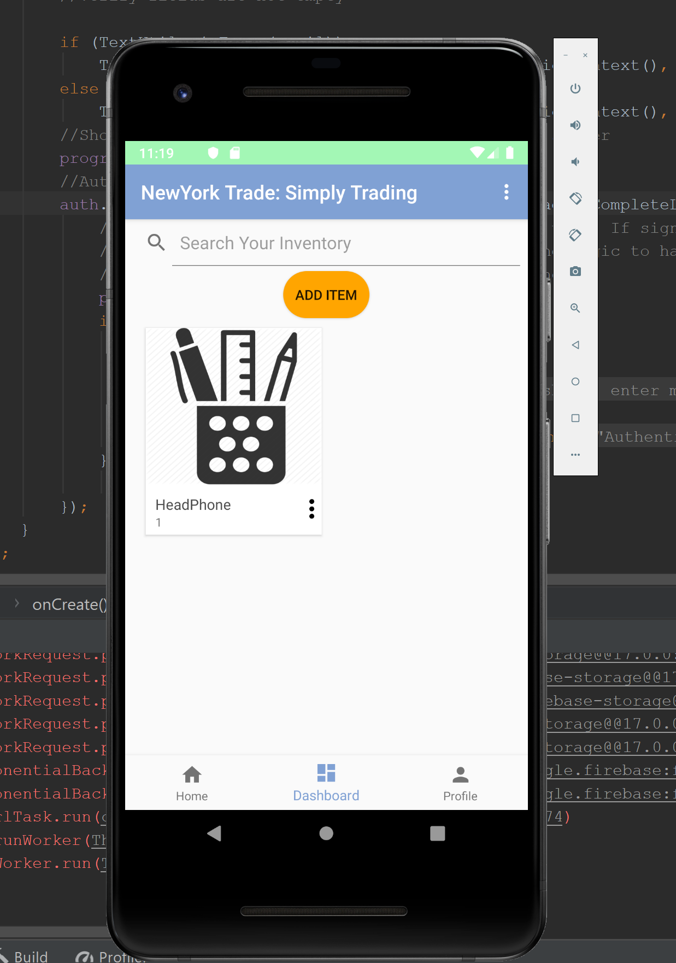
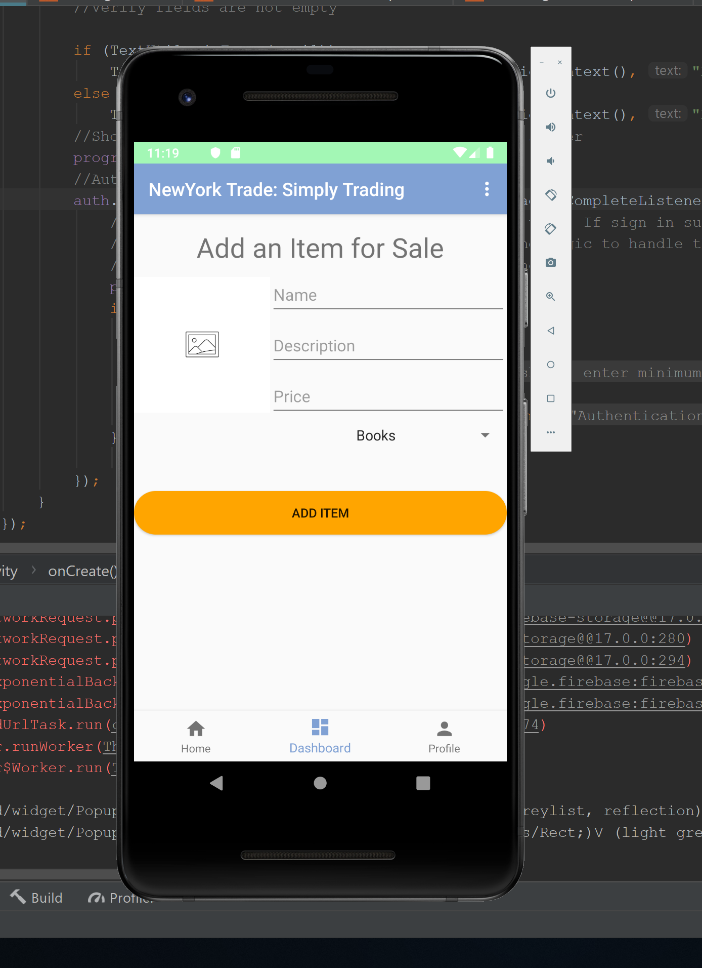
Dashboard: Selling Information

Slide 9
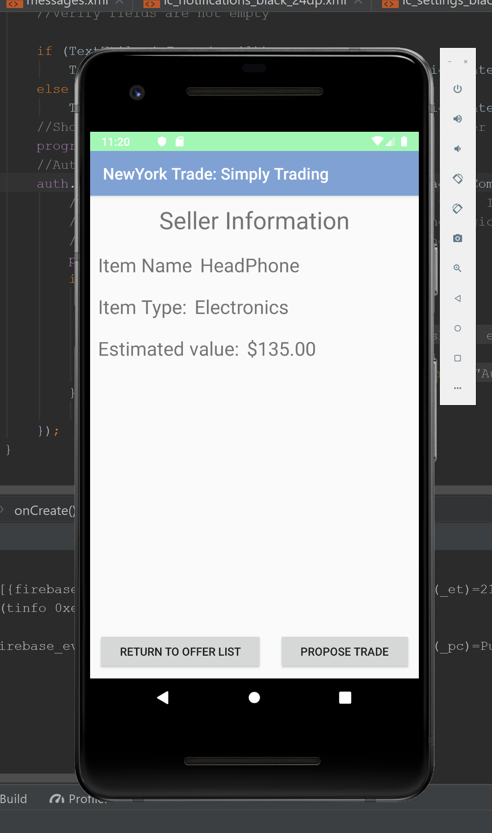
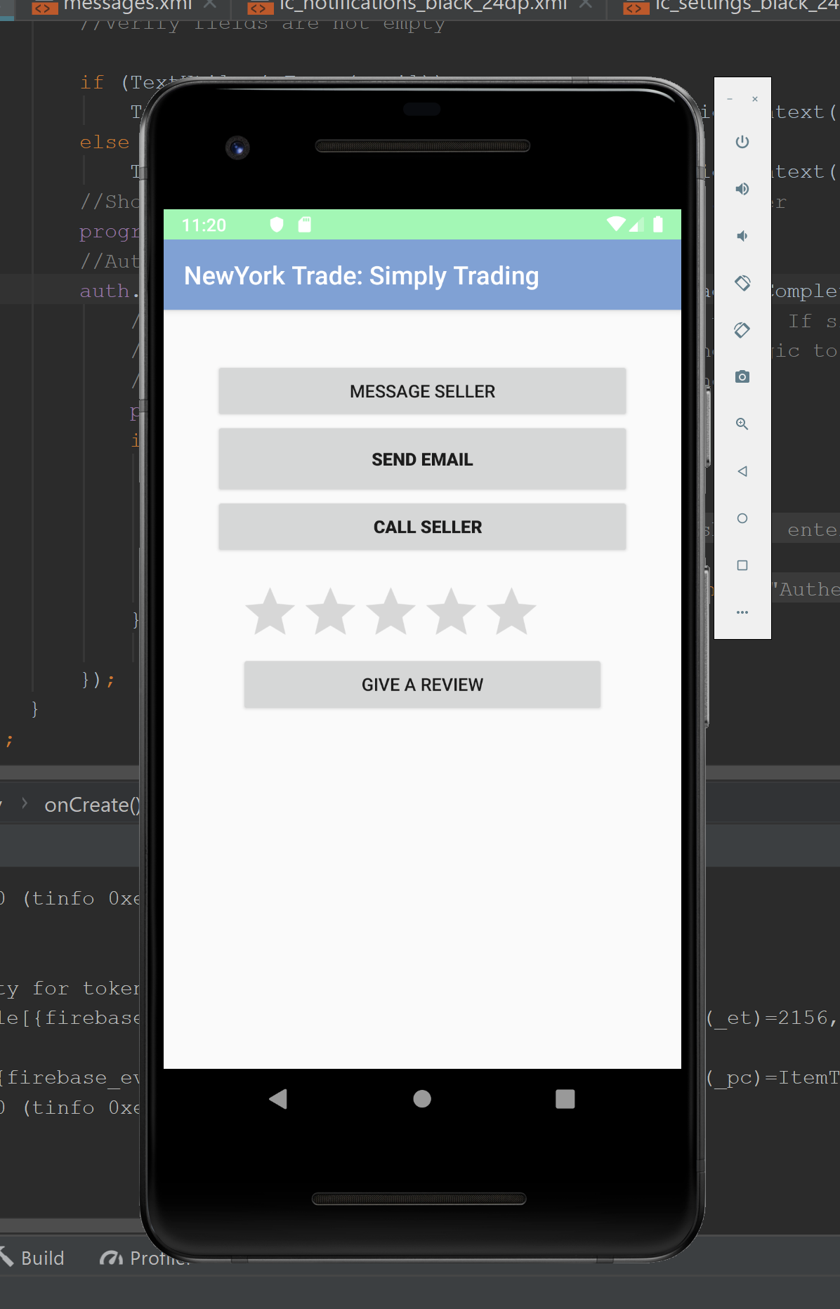
Seller Information / Purposing Trade

Slide 10
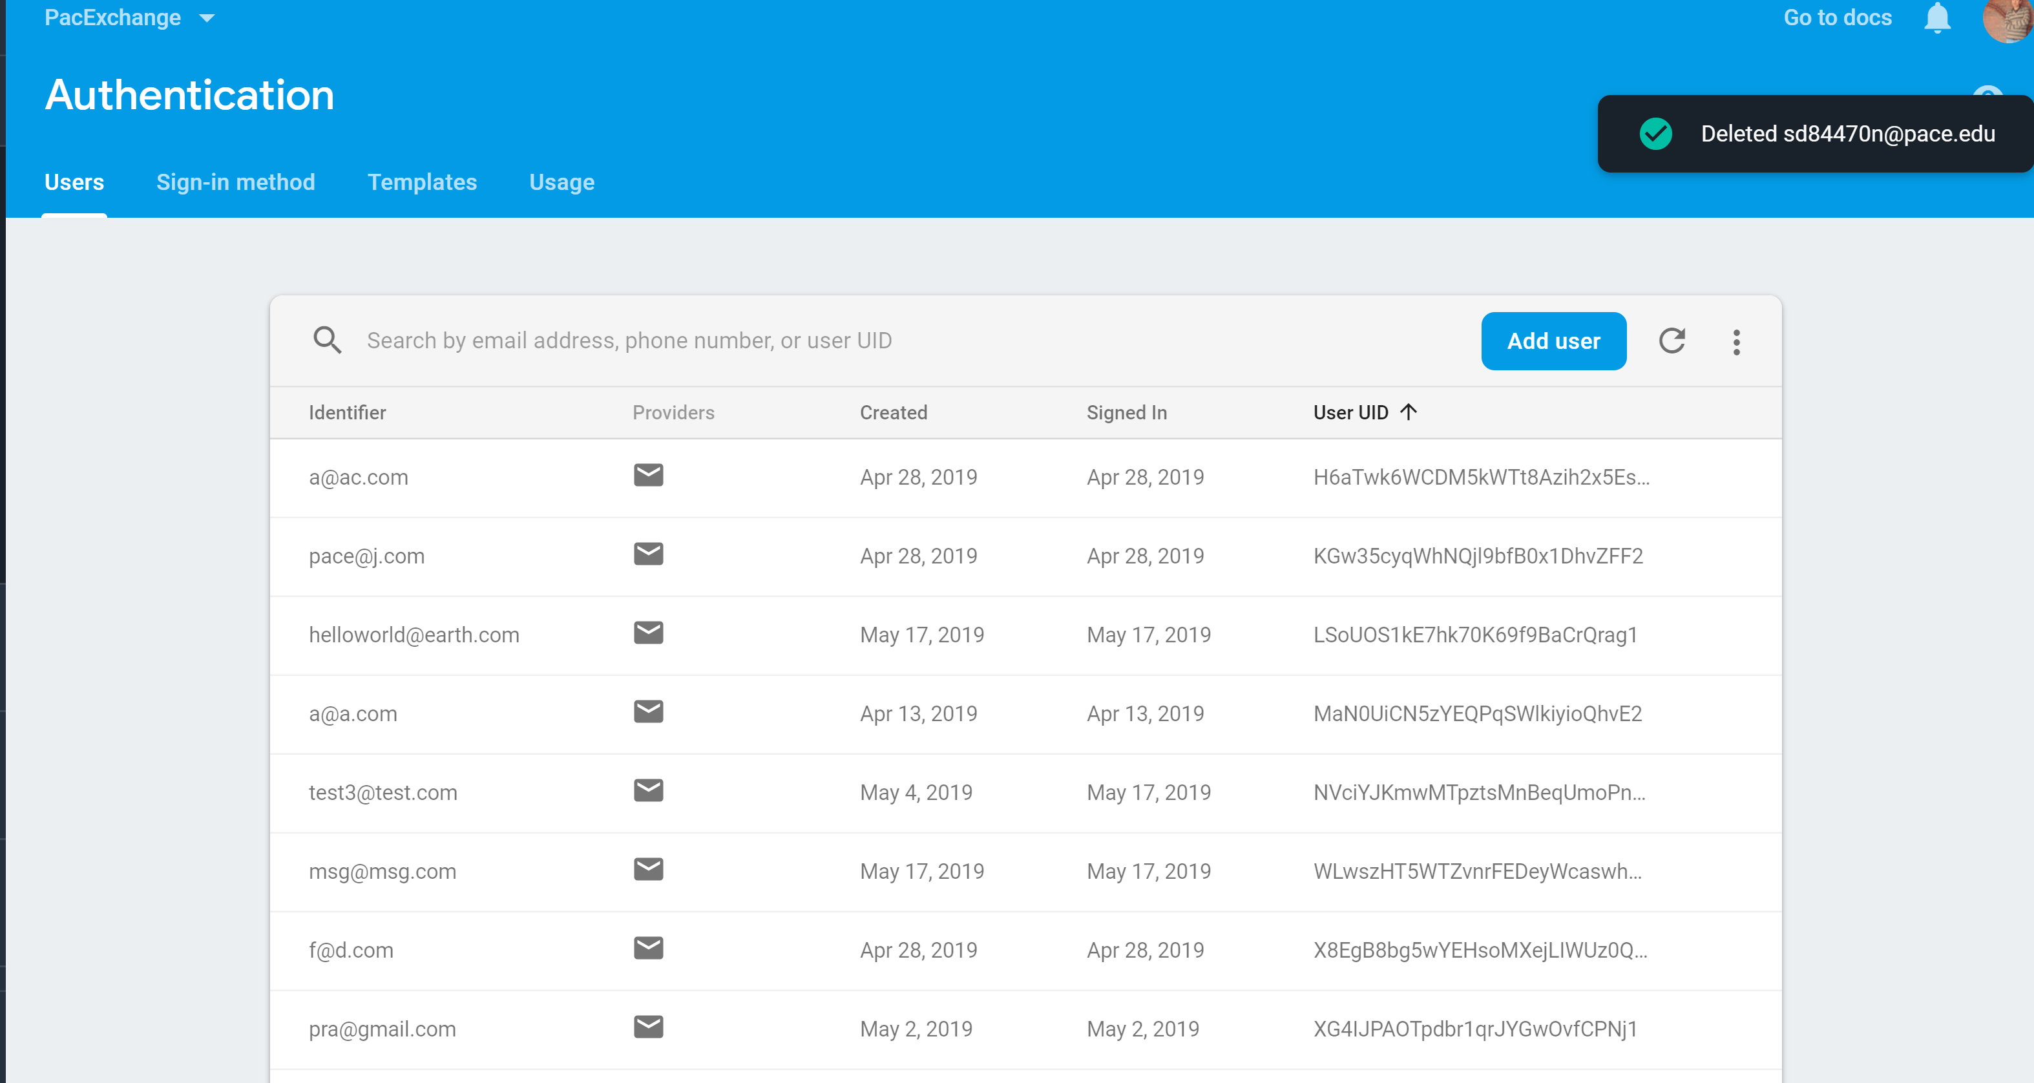
Firebase Authentication

Slide 11
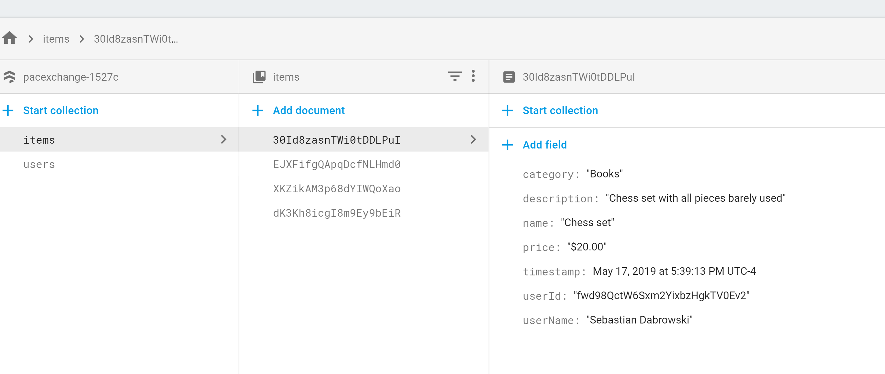
Realtime Database from Firebase

Slide 12
Resources
https://www.androidhive.info/2016/06/android-getting-started-firebase-simple-login-registration-auth/
https://firebase.google.com/docs/storage/web/start
https://developer.android.com/docs

